Slide 1

NON INVASIVE DIABETES DETECTION BY GAS SENSOR USING IOMT
.
GUIDED BY:
Ms.R.DARSHINI
TEAM MEMBERS:
ANUSURYA S [210421121004]
DHARSHINI P [210421121012]
UDHAYA GEETHA S [210421121053]

Slide 2
PROBLEM STATEMENT
Diabetes is a most common disease caused by a group of metabolic disorders.
Common diabetic test on patients are done on urinary test and blood ketone test to monitor for diabetes condition.
However, those methods are considering as invasive, inconvenient and expensive.
Hence the system of non-invasive detection are consider as convenient and less expensive method.

Slide 3
LITERATURE REVIEW
Sl. No | Title of the Paper | Authors | Name of the Journal, Year, Volume, Issue | Observation
1 | MEMS-Based Acetone Vapor Sensor for Non-Invasive Screening of Diabetes | Almur A.S.Rabih, Member, J. O. Dennis , Senior Member, A.Y.Ahmed , Member, IEEE. | IEEE SENSORS JOURNAL, VOL. 18, NO. 23, DECEMBER 1, 2018 | MEMS sensor device fabricated using PolyMUMPs technology, and proposed for use to detect acetone vapor in the exhaled breath for possible non-invasive screening of diabetes.
2 | A Review of Biosensors for Non-Invasive Diabetes Monitoring and Screening in Human Exhaled Breath | FAHAD, J.O.DENNIS A.Y.AHMED, FABRICE MERIAUDEAU B.AYODELE, AND ALMUR A. S. RABIH | IEEE Access, vol. 7, pp. 5963-5974, 2019, doi: 10.1109/ACCESS.2018.2887066 | The performance characteristics of the biosensors have been explored for comparison. The future trends are also highlighted.
3 | IoT Enabled Non-Invasive Detection and Classification of Diabetes using Breath Acetone | Shahina M, Anusree L, Assistant Professor | Volume 2, Issue 12, December– 2017 International Journal of Innovative Science and Research Technology | Main objective of this work is to present a easy handheld healthcare monitoring system for diabetic level measurement using IoT.

Slide 4
LITERATURE REVIEW
Sl. No | Title of the Paper | Authors | Name of the Journal, Year, Volume, Issue | Observation
4 | Diabetes Detection using Sensor | Prof. Ganesh Deshmukh, Mansi Bhosale, Manisha Chavan, MadhuriKamble, Rutuja Tilekar. | International Research Journal of Engineering and Technology , Volume: 08 Issue: 07 | July 2021 | In this paper, we present a method to detection of diabetes using a sensor. With the help of the noninvasive method, the patient can easily check the glucose levels.
5 | DIABETES PREDICTION USING SENSORS BY ANALYSING SKIN TEMPERATURE | SASIKUMAR B. NAVEENRAJU D, ANAND K , HARIHARAN S, SUDHAKAR BHARATHIRAJA | Journal of Engineering Science and Technology Vol. 15, No. 2 (2020) 1357 - 1370, Taylor’s University | The results obtained were more promising and compared with several other existing schemes. The result was analysed using physicians who have agreed on the inference obtained using the study.
6 | BREATH ACETONE-BASED NON-INVASIVE DETECTION OF BLOOD GLUCOSE LEVEL | Anand Thati , Arunangshu Biswas, Shubhajit Roy Chowdhury1 and Tapan Kumar Sa | JOURNAL ON SMART SENSING AND INTELLIGENT SYSTEMS VOL. 8, NO. 2, JUNE 2015 | The test results show that it is possible to measure the blood glucose levels via breath acetone sensing. The accuracy of the system can be improved with a large set of data.

Slide 5
LITERATURE REVIEW
Sl. No | Title of the Paper | Authors | Name of the Journal, Year, Volume, Issue | Observation
7 | Design of a noninvasive diabetes detector based on acetone recognition | Y C Jiang , M J Sun and R J Xiong | IOP Conf. Series: Journal of Physics: Conf. Series 1026 (2018) 012009 doi:10.1088/17426596/1026/1/12009 | The experiment shows that the system is effective and convenient in detecting low concentrated acetone exhaled by the patients, and an innovative product inspired by this may be prospective to be put into use in certain areas.
8 | Micro Gas Sensors for Detection of Acetone for Non-Invasive Diabetes Monitoring | Joshitha C, K.Teja Venkata Reddy | Annals of R.S.C.B., ISSN:1583-6258, Vol. 25, Issue 4, 2021,; Accepted 01 April 2021 | An exposure model was used to show the necessary acetone, a heat transfer model was used to determine the reaction temperature, and an electric model was used to complete the simulation.
9 | Detecting acetone from breath using a PrFeO3-doped PANi/TiO2-coated PAN nanofiber sensor for non-invasive diabetic diagnosis | Nesibe Yesildaga, OmerFaruk Unsala, | J. Innovative Eng. Nat. Sci., vol. 3, no. 2, pp. 153-166, 2023. | These results suggest that PrFeO₃-doped nanofibers hold promise as potential candidates for acetone gas sensors in non-invasive diabetes monitoring.

Slide 6
EXISTING SYSTEM
Gas Sensors: The core component of this system is the gas sensor. These sensors are designed to detect volatile organic compounds (VOCs) or specific gases that are indicative of diabetes-related metabolic processes.
Data Collection: Patients wear or use the gas sensors in a noninvasive manner, such as breathalyzers or wearable devices. These sensors continuously monitor and collect data, measuring the concentration of specific gases.
IoMT Connectivity: The gas sensors are connected to the IoMT platform through wireless communication protocols like Wi-Fi, Bluetooth, or cellular networks. This allows real-time data transmission to a central server or cloud-based platform.
Patient Monitoring: Patients can access their own data through a mobile application or web portal, allowing them to track their glucose levels and receive health recommendations based on the data. Healthcare providers can also monitor patient data remotely and intervene when necessary.

Slide 7
PROPOSED SYSTEM
The proposed system is a promising innovation in the field of healthcare technology.
By integrating advanced gas sensors with IoMT, it offers a non-invasive solution for both diabetes detection and continuous glucose monitoring.
This approach addresses the critical need for painless and real-time monitoring, potentially improving patient compliance and overall diabetes management.
However, the system's effectiveness would depend on the accuracy of gas sensors and the reliability of data analysis algorithms.
Additionally, navigating regulatory approvals and ensuring data privacy would be key challenges to overcome.
If successfully developed and validated, it has the potential to make a significant positive impact on diabetes care and patient well-being.

Slide 8
WORKING
Sensor Selection: Careful selection of advanced gas sensors capable of detecting relevant volatile organic compounds (VOCs) associated with diabetes.
IoMT Integration: Integration of the selected sensors into the Internet of Medical Things (IoMT) framework for real-time data transmission and monitoring.
Data Collection: Collecting a diverse dataset of gas sensor readings from individuals with and without diabetes for algorithm development and validation.
Algorithm Development: Employing machine learning and data analysis techniques to develop algorithms that can accurately distinguish between diabetes-related VOC patterns and those of healthy individuals.Develop an algorithm that predicts future glucose levels based on historical data by using ARIMA, LSTM, GRU, or Transformer models,Control algorithms that regulate insulin delivery for closed-loop systems.

Slide 9
WORKING
Accuracy Assessment: Rigorous testing and validation of the gas sensors and algorithms using a controlled environment and clinical data to ensure accuracy.
Regulatory Compliance: Navigating regulatory approvals and compliance with healthcare data security and privacy regulations to ensure the system's legality and safety.

Slide 10
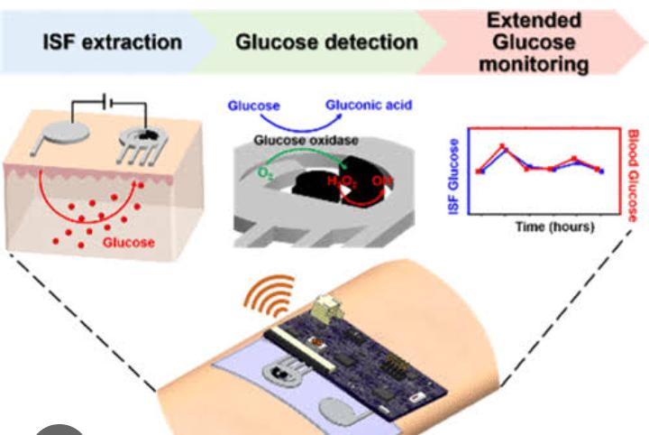
PHOTOSNAP OF PROJECT flow diagram PHOTOSNAP OF PROJECT

Slide 11
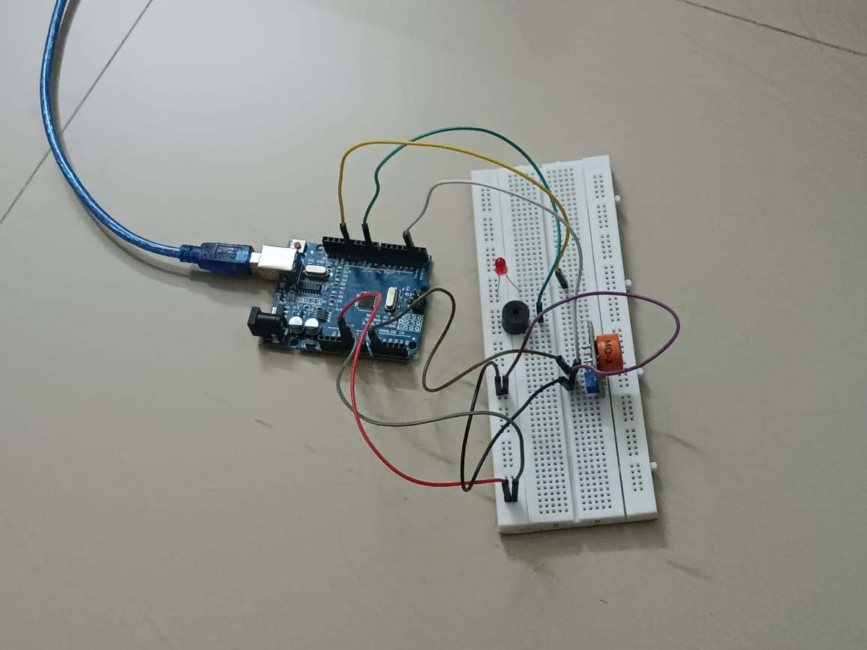
Project Photo

Slide 12
Future Phase
Wearable biosensors capable of continuously monitoring blood glucose levels without the need for skin penetration.
Enhanced imaging techniques, like advanced infrared spectroscopy or advanced optical coherence tomography, to detect subtle changes in tissue structure associated with diabetes.
Integration of artificial intelligence algorithms to analyze data from various noninvasive sources, offering personalized insights and predictions for diabetic management.
Development of smart contact lenses or other noninvasive devices for continuous monitoring of glucose levels in tears or other bodily fluids.

Slide 13
Result
The successful implementation of this system would have a significant impact on diabetes management and healthcare practices by offering a convenient, non-invasive, and accurate method for monitoring diabetes.
It could potentially lead to earlier diagnosis, improved patient outcomes, and a reduction in the burden on healthcare systems by decreasing the number of invasive diagnostic procedures

Slide 14


